Slide 1
Sprint 10 Demo
Wednesday, September 7th , 2022

Slide 2



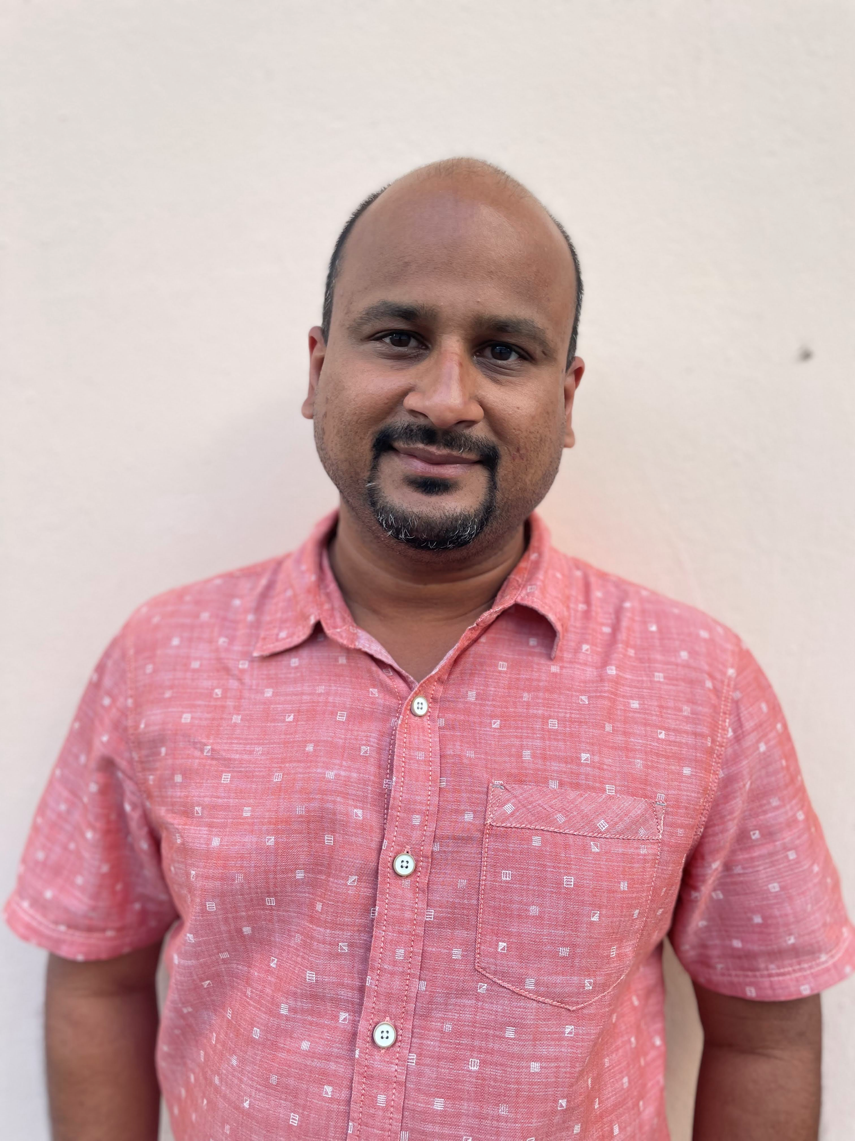




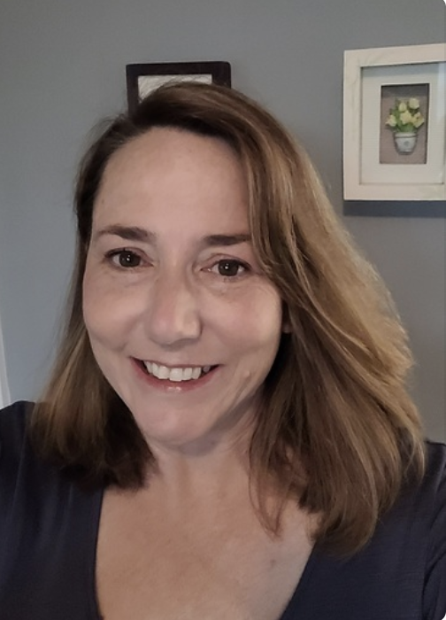





Get to know the team
Core team
Executive team
PRODUCT
DESIGN
ENGINEERING
Jeanette Cantrell
Chantilly, VA
Product Lead
Thomas McCue Oak Park, IL Principal Designer
Deb Dennis Oakland Hills, CA UX Researcher
Health Hub only
Shashank
Khandelwal
Rockville, MD
Tech Lead
Teagan Stephenson
Ft. Lauderdale, FL
Full Stack Engineer
1095-B Product only
Jeff Scheire
MO Studio
Marcy Jacobs
McKinsey & Co
Kevin London Frog Design
Tami Corson
New Bern, NC
Clinical SME / Scrum
Carl Dickerson Atlanta, GA Content Strategist and Plain Language Content Creator
Carolyn Williams Chicago, IL Experience Designer
Dan Smith
Charleston, SC
QA Engineer / 508 Specialist
Will Reynolds SERVE Advisory
Ben Morris
Pluribus Digital
09-07 Sprint 10 Demo
Introduction

Slide 3



At the end of each sprint on Tuesdays, the team will run sprint reviews to showcase the sprint’s work for approval. The purpose of this meeting is:
WELCOME TO THE SPRINT 10 DEMO
1
To demo the accomplishments or functionality that was built over the past sprint
2
To get feedback and insights early and often
3
To create transparency for anyone interested on the product and progress
09-07 Sprint 10 Demo
Introduction

Slide 4
CEDAR TO1 Overview
WE ARE HERE
CY 2021
CY 2022
PHASE
SPRINT
0
1
2
3
4
5
6
7
8
9
10
11
12
13
14
15
16
17
18
19
20
21
22
23
24
25
MONTH
Sep
Oct
Nov
Dec
Jan
Feb
Mar
Apr
May
Jun
Jul
Aug
Sep
DHM - Health Apartment
FOCUS
1095-B Form
Community Care
Health Hub
09-07 Sprint 10 Demo
Introduction

Slide 5
Agenda
HEALTH HUB
Sprint Goal:
For sprint 10 we focused on preparing for transfer of 1095-B work to the new team via staging review, testing / updates, documentation and discussions; and conducting Health Hub moderated studies and performing synthesis of findings.
Data gathering
Research synthesis
1095-B
Staging review
Testing approach and progress for 1095-B
Other updates
POST-MVP OPT-IN AND TURNOVER PLAN
Transition of ownership
 | We welcome all feedback! Feedback will be collectively reviewed and prioritized appropriately based on where it stacks against other stories in the backlog as well as technical feasibility.
09-07 Sprint 10 Demo
Agenda

Slide 6
Health Hub
SPRINT 10 DEMO
09-07 Sprint 10 Demo

Slide 7



Health Hub Workplan v9
Owned by product team
WE ARE HERE
SPRINT 1
4/20 – 5/03
SPRINT 2
5/04 – 5/17
SPRINT 3
5/18 – 5/31
SPRINT 4
6/01 – 6 /14
SPRINT 5
6/15 – 6/28
SPRINT 6
6/29 – 7/12
SPRINT 7
7/13 – 7/26
SPRINT 8
7/27 – 8/09
SPRINT 9
8/10 – 8/23
SPRINT 10
8/24 – 9/6
Kickoff
Discovery
Build Roadmap
Product & Delivery
Build initial workplan and backlog
Business partner discovery
Moderated IA treejack Research
Moderated IA treejack interviews & synthesis
User Experience & Design
Comparative research
Consolidate existing research
Experience Map
Current state mapping
Research Activities Plan (RAP)
IA Tree Test Plan H0 & H1
Final IA Recommendations delivered
Engineering & Development
Tech Discovery
09-07 Sprint 10 Demo
Health Hub

Slide 8
A
Moderated Tree Test Study: Data Gathering
10 Veteran moderated studies were completed this sprint, bringing the total number of participants for the study to 22*.
Veterans were separated into 4 cohorts to test our hypotheses
Cohort 1: H0, Veterans with health care
Cohort 2: H1, Veterans with health care
Cohort 3: H0, Veterans without health care
Cohort 4: H1, Veterans without health care
Cohort | Sprint 10 Studies | Total Studies
Cohort 1 Hypothesis 0 - Veterans with health care | 1 | 6
Cohort 2 Hypothesis 1 - Veterans with health care | 1 | 6
Cohort 3 Hypothesis 0 - Veterans eligible without health care | 4 | 5
Cohort 4 Hypothesis 1 - Veterans eligible without health care | 4* | 5*
*Participant 46 did not meet requirements for study.
09-07 Sprint 10 Demo
Health Hub
8
Notes:
Thomas

Slide 9
B
Moderated Tree Test Study: Synthesis
A complete synthesis can be found in the findings document referenced in the link below. It contains background and details on the following key findings:
 | So my health is everything that has to do with you? "Yes."
Mission-critical content would benefit from multiple paths, elevation in the IA, and more direct navigation access/availability
While “My Health” provided an intuitive go-to location for “Manage” tasks, it was often not considered for “Get” content and tasks
Labeling and taxonomy bear improvement; Clear, concise language and familiar keywords
Mental Health should be easier to find with fewer steps to in navigation
Copay, Travel pay, and other financial content and tools could benefit from better organization, labeling, and definition
 | "The way I am looking at my health is if I am already enrolled."
 | “Labels were not my favorite, some drop downs were detailed enough to figure it out but also comes from experience working in MHV, but if I was clueless I would be totally confused"
 | "In my mind I'm looking for a mental health tab"
Research synthesis deck
09-07 Sprint 10 Demo
Health Hub
9
Notes:
Thomas Deb Carl

Slide 10
1095-B
SPRINT 10 DEMO
09-07 Sprint 10 Demo

Slide 11

1095-B Workplan v10
Collab cycle tollgates
WE ARE HERE
SPRINT 7
4/20 – 5/03
SPRINT 8
5/04 – 5/17
SPRINT 9
5/18 – 5/31
SPRINT 10
6/01 – 6/14
SPRINT 11
6/15 – 6/28
SPRINT 13
6/29 – 7/12
SPRINT 14
7/13 – 7/26
SPRINT 15
7/27 – 8/09
SPRINT 16
8/10 – 8/23
SPRINT 17
8/24 – 9/6
1095-B: Spanish translation docs
Turnover document of remaining post-MVP work (VA notify, 2022 IRS form, 508 compliance, multiple year selection)
1095-B: Legal Review
1095-B: Legal Review – Opt-in
Product & Delivery
VA 508 Assistance request
MVP 508 Spanish translation docs
Kickoff
Align on launch MVP v. MVP w/ opt-in
Design for opt-in
User Experience & Design
Notification flow
Design for MVP 508 accessibility
Build for accessible MVP
Engineering & Development
Plan for and facilitate post MVP opt-in
Build for Analytics
Collaboration Cycle
Sitewide and Content IA ticket opt-in
Call center review
Analytics & QA
MVP staging review
Security &
privacy review
09-07 Sprint 10 Demo
Workplan
11

Slide 12
A
Staging review
Four minor (non-blocking) issues were identified during staging review
Finding | Status
[Assistive tech and device support] Alert and status messages aren't announced without receiving focus. (11.22.1) | In progress
[Link and button labels] Your content doesn't use correct and consistent labels across links, entry points, navigation components, and H1s. (08.02.1) | The design file is incorrect, but the text on the mobile and desktop versions of the code matches.
[Components and pattern standards] Design components or patterns don't align with Design System guidelines. (04.07.1) | The design file is incorrect, but the code is implemented correctly. Ticket is closed.
[Content organization] Your page doesn't follow heading hierarchy. Headings aren't properly nested, and headings and/or labels aren't relevant to the page. (02.04.1) | In progress
09-07 Sprint 10 Demo
1095-B
12

Slide 13
B
Testing approach and progress for 1095-B
Testing the 2021 data load
We’ve read approximately half the 16 1095-B data files with no further data-related errors. Fixes include:
Allowing most data to be empty including first name, last name, city, country
Allowing ‘null’ string in the data
Testing loaded data using the API
We were able to use the browser console to successfully test with one Veteran from VA
User was able to download text and PDF versions of their 1095-B and verify that the data was correct 🎉
Testing the 1095-B page + React widget in staging
The #sitewide-public-website team’s work is done
Staging URL*: https://www.staging.va.gov/download-your-irs-1095-b-tax-form
* The sitewide-public build didn’t complete this morning
09-07 Sprint 10 Demo
1095-B
13

Slide 14
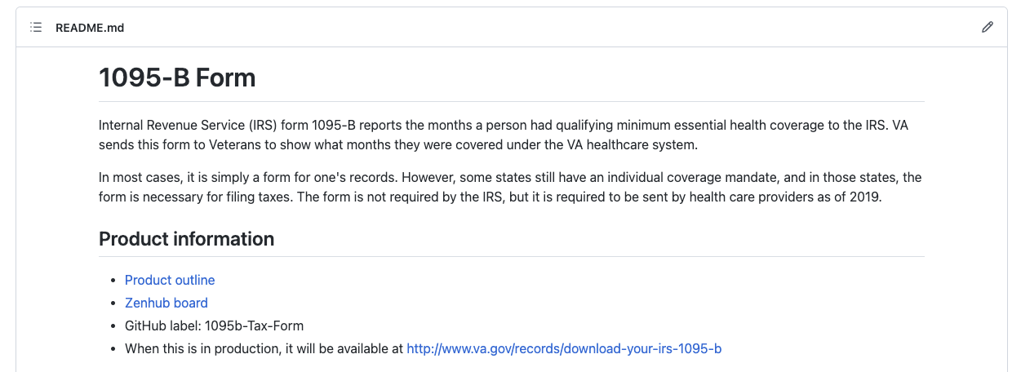
C
Other updates
Transition
Met with Mark Dewey to chat about the status of 1095-B and answer any questions
Documentation updates
Restructured the product README file to follow the product roadmap and there be easier to read
The 1095-B form format may change annually. We documented how to handle annual changes.
Created documentation on how to test the API using the browser console
09-07 Sprint 10 Demo
1095-B
14

Slide 15
Our remaining steps 1095-B MVP (1 of 2)
Delayed
In progress
Completed
Not started
E
STEP | OWNED BY | ACTION NEEDED | DATE ENTERED | STATUS | NOTES
Contact center review | 1095-B / Contact center | Artifacts to be quality reviewed by Contact center staff | 22-Jul-22 |  | Closed 8/9/22
Analytics implementation | 1095-B / Analytics | Ticket completion and alignment on KPIs | 27-Jul-22 |  | Google analytics is sufficient, if board desired, place ticket after launch per Michelle Dooley on ticket #44810
Privacy, security, and infrastructure review | 1095-B / Security | Ticket completion and all 9 artifacts attached | 27-Jul-22 |  | Closed 8/11/22
 |  | Product outline | 27-Jul-22 |  | Completed 8/4/22
 |  | Release plan | 27-Jul-22 |  | Completed 8/5/22
 |  | Incident response plan (IRP) / Playbook | 27-Jul-22 |  | Completed 8/9/22
 |  | Architecture diagram | 27-Jul-22 |  | Completed 8/9/22
 |  | Sequencing diagram | 27-Jul-22 |  | Completed 8/9/22
 |  | Data Flow diagram | 27-Jul-22 |  | Completed 8/8/22
 |  | API Endpoint document (located in IRP) | 27-Jul-22 |  | Complete 8/19/22
 |  | Accessibility file | 27-Jul-22 |  | 5 out of 6 tests complete; Axe scan to be done once in staging environment
Resolve transport script / bucket | 1095-B / HEC | Reopen bucket ticket (GitHub #38079) and ensure Joshua (HEC) has access to appropriate buckets to fill transport script | 9-Aug-22 |  | Completed 8/20/22
09-07 Sprint 10 Demo
1095-B

Slide 16
Delayed
In progress
Completed
Not started
Our remaining steps 1095-B MVP (1 of 2)
STEP | OWNED BY | ACTION NEEDED | DATE ENTERED | STATUS | NOTES
Scenario testing of loaded product | 1095-B | Complete scenario testing and PR’s for loaded product to include updating any deprecated design components and other staging tests | 17-Aug -22 |  | Sprint 9/10
Staging review | 1095-B / Collab Cycle teams | Complete product ticket with documented previous collab cycle steps initiated and under async review. Platform notified of status 4 business days prior to meeting in order to review all artifacts and post recommendations. | 13-Jul -22 |  | Completed 06-Sep-22
In staging testing | 1095-B/Public websites | Build method to conduct usability testing of react widget on static Drupal page with authentication dependent data. Commence internal testing with VFS Veterans with PIV and VA.gov Veteran credentials | 21-Aug-22 |  | Staging URL: https://staging.va.gov/download-your-irs-1095-b-tax-form
09-07 Sprint 10 Demo
1095-B

Slide 17
Path to Task Order close-out
SPRINT 10 DEMO
09-07 Sprint 10 Demo

Slide 18
CEDAR TO1 closeout (1 of 2) v1
Delayed
In progress
Completed
Not started
STEP | OWNED BY / TURNOVER TO | ACTION NEEDED | COMPLETED | STATUS | NOTES
Completion of HH research #1 w/ caregivers | HealthHub / Mikki | Amend research plan to initiate final unmoderated testing of remaining caregivers | 9-Aug-22
 |  | Submit research plan for recruitment by Perigean | 9-Aug-22
 |  | Put research plan, guide, data sets, and synthesis in GitHub HH repo turnover README | 23-Aug-22
Completion of HH research #2 – Moderated tree test | HealthHub / Mikki | Submit research #2 to Mikki for feedback and approval | 8-Aug-22
 |  | Submit research #2 to oCTO for approval and recruitment (Must request Perigean note taker service) | 9-Aug-22
 |  | Conduct pilot testing | 11-Aug-22
 |  | Conduct moderated testing of trees | 6-Sep-22
 |  | Synthesis research findings and make recommendation if able | 6-Sep-22
 |  | Put research plan, guide, data sets, Perigean notes, synthesis, recommendations (if able) in GitHub HH repo turnover read.me. | 7-Sep-22
HH Turnover document | HealthHub / Mikki & Tracey | Turnover document (include links to discovery, all research documents, and recommended next steps. Place in Health Hub turnover read.me file. Send link to Mikki Northius & Tracey Mulrooney for review / edits | 7-Sep-22
09-07 Sprint 10 Demo
TO1 Closeout

Slide 19
CEDAR TO1 closeout (2 of 2)
Delayed
In progress
Completed
Not started
STEP | OWNED BY / TURNOVER TO | ACTION NEEDED | COMPLETED | STATUS | NOTES
HEC requirements ticket | 1095-B / HEC | Provide business requirements for Tarsha (HEC) to submit ticket | 13-Aug-22
Analytics | 1095-B | Implement analytics in pre-staging and provide implementation monitoring status / turnover | 01-Sep-22 |  | Initiated sprint 8, DOMO de-prioritized by Platform analytics; GA has all points, if report board is required, please submit request after launch
HEC written approval | HEC / 1095-B | Obtain and upload into product repo written approval of MVP design and content prior to launch (Due 21-Aug-22 to avoid shifting timeline) |  |  | Communication required between HEC and VA-PO [Launch blocking dependency]
Research plan - Moderated UAT | 1095-B | Create research plan, and conversation guide for moderated UAT for approval of VA research team and submission to Perigean for recruitment. Placed in repo for utilization by next team | 30-Aug-22
HEC Spanish translated documents | 1095-B | Monitor status of 1095-B translation of HEC documents from State Department via Sitewide (Randi Hecht) and turn over to business owner (Tarsha Tremble) | 22-Aug-22
1095-B Turnover document (MVP and Opt-in) | 1095-B / Tracey & Health Apps team | Turnover document (include links to discovery, research documents, collaboration cycle product documents, Opt-in build plan, and recommended next steps with owners timelines. Place in GitHub README turnover document. Send link to VA-PO for review. | 07-Sep-22
Turnover meeting | 1095-B / Health Apps | Tracey will arrange a 30-minute meeting with Health Apps team to review product 9 and a 60-minute meeting to review turnover README document and plan for next steps. Additionally, team will be available for asynchronous questions after initial meeting. | 01-Sep-22
09-07 Sprint 10 Demo
TO1 Closeout

Slide 20
1095-B Product Turnover
SPRINT 10 DEMO
09-07 Sprint 10 Demo

Slide 21
Next steps for new team v3 (1 of 3)
Delayed
In progress
Completed
Not started
STEP | OWNED BY | ACTION NEEDED | COMPLETED | STATUS | NOTES
Staging review | 1095-B / Collab Cycle teams | Complete product ticket with documented previous collab cycle steps initiated and under async review. Platform notified of status 4 business days prior to meeting in order to review all artifacts and post recommendations. |  |  | Staging review conducted on 06-Sep-2022 with four issues that are non-launch blocking (with one already closed)
Research plan - Moderated UAT | 1095-B / Perigean / VA Research | Create research plan, and conversation guide for moderated UAT for approval of VA research team and submission to Perigean for recruitment. |  |  | Draft README, routing dependent on dates determined by new team
Moderated UAT | 1095-B | Moderated usability testing with Veteran’s recruited through Perigean. TBD. Record findings in product release plan
HEC written approval | HEC / 1095-B | Obtain and upload into product repo written approval of MVP design and content prior to launch |  |  | [Launch blocking dependency] Presentation to Mr. Echols conducted 9/16/2022. Communication between HEC and VA-PO required for approval
Staged Rollout | 1095-B | Roll out of product on VA.gov will be staged and include feature toggle. Canary test 25% TBD; Stage B 50% TBD. Incident response plan will be followed if product fails to perform as desired.
Analytics reporting | 1095-B | GA covers page, if report page requested, submit ticket with Platform analytics after launch
Go Live | 1095-B | Official go-live
09-07 Sprint 10 Demo
Next steps

Slide 22
Next steps for new team v3 (2 of 3)
Delayed
In progress
Completed
Not started
STEP | OWNED BY | ACTION NEEDED | COMPLETED | STATUS | NOTES
Post launch review (1 week) | Health Apps | Complete post launch assessment in product release plan. Due 12-Sep-22
Post launch review (1 month) | Health Apps | Complete post launch assessment in product release plan. Due 5-Oct-22
Opt-in legal review | Health Apps MyVA OGC | Put together a legal package (product outline, static page opt-in designs / content, MyVA opt-in designs / content) for review by OGC. Coordinated through HEC (Tarsha). |  |  | [Opt-in launch blocking dependency] Raun, Eric L. (OGC) <Eric.Raun@va.gov> Case# GCL 158655 Lawyer POC who reviewed MVP OGCHealthCareLawGroupAttorneys@va.gov General legal assistance email request line. Request submitted via email 9/5/2022
Wayfinding | Health Apps Sitewide | Submit intake ticket with sitewide with IA document, user path, and crosslinks to wayfinding to create wayfinding to 1095-B page. Takes 1-2 Sprints.
Opt-in: Build 1095-B paperless preference on Veterans VA.gov profile page | MyVA | On the MyVA Veteran Profile preferences page, the user can opt-in to receive the 1095-B form digitally. This will start the data flow to stop the physical form from being mailed out to the user during tax season. It’ll take about 8 sprints to do this work (3.5 months) The team started 8/2/2022 |  |  | MyVA Veteran profile opt-in designs complete 16-Aug-22. Legal review document initiated. Additional work placed on hold by VA-PO 18-AUG-22
Opt-in: Storage of Veteran preferences for audit trail | VA Profile/ MyVA | This preference is consumed and stored. We’ll also need an audit trail for when the preference is changed, in case VA gets audited by the IRS. Work in coord. w/ MyVA.
09-07 Sprint 10 Demo
Next steps

Slide 23
Next steps for new team v3 (3 of 3)
Delayed
In progress
Completed
Not started
STEP | OWNED BY | ACTION NEEDED | COMPLETED | STATUS | NOTES
Opt-in: Data push to ES | VA Profile | Interaction with enrollment services to synchronize the preference data. This will be implemented as a push notification fired on a per-veteran-per-profile change basis.
Opt-in: Data synch with VA Profile | HEC- ES | Change a field in the 1095-B print file, synchronizing the preference data. Business requirements submitted 8/11/22. Requested delivery of work December 1, 2022. |  |  | HEC ES work deprioritized to Mar 2023
Opt-in: Link 1095-B page to Veterans profile | Health Apps Sitewide MyVA | Submit intake ticket with sitewide to build onto 1095-B Drupal page the opt-in design element (alert link) since opt-in element is the same in unauth and auth environment. opt-in designs
Opt-in: Communications plan | Health Apps | Build a communications plan for opt-in to advertise service, tax season notification for those who have opt-in. Sample veteran communication used by eBenefits. Draft notifications here
Removal of feature toggle code | Health Apps | Submit ticket to remove code for feature toggle on react widget after opt-in is built and functioning for 1 entire tax season
Consider site enhancements | Health Apps | Build for multi-year retrieval (3yrs best practice) and then on-site digital correction of information
09-07 Sprint 10 Demo
Timing for opt-in collaboration / build to be monitored by New 1095-B team (aka Health Apps)
Next steps

Slide 24
Sprint Deliverables
SPRINT 10 DEMO
09-07 Sprint 10 Demo

Slide 25
Sprint 10 Deliverables (1 of 2)
EPIC | STORY | ESTIMATE | ASSIGNED | OUTPUT | REVIEWED W/ VA-PO | SPRINT TEAM GOAL COMPLETED?
Research | #46157 Continue moderated testing of IA trees | 3 | Carl Deb | Transcription | 9/07/2022 | ✓
Research | #46158 Synthesis research findings | 8 | Deb | Research synthesis | 9/07/2022 | ✓
Research | #46159 Presentation and deck of research synthesis (#2) using VA format | 5 | Deb Carolyn | Research synthesis | 9/07/2022 | ✓
Transition | #45592 Finalize transition of product ownership document: HH | 3 | Thomas | README doc in GitHub | 9/07/2022 | ✓
Transition | #45593 Hold transition of ownership meeting w/ Mikki Northius | 3 | Thomas | N/A | 9/07/2022 | ✓
Design | #46363 Update documents w/ new Drupal content for address change 1095-B | 3 | Thomas Carl Tami | MVP designs 8.1.22 | 9/07/2022 | ✓
Collab | #46185 Update product guide w/ new toggle message 1095-B | 3 | Carl | Toggle design | 9/07/2022 | ✓
Collab | #44810 Collaboration cycle: Analytics implementation | 0 | Shashank | Ticket | 9/07/2022 | ✓
Collab | #44401 Collaboration cycle: Staging review | 0 | Jeanette | Ticket | 9/07/2022 | ✓
Analytics | #45846 Analytics KPI dashboard request for 1095-B | 1 | Shashank | Ticket | 9/07/2022 | ✓
Staging | #46636 Assistive tech and device support: Alert and status messages aren’t announced without receiving focus | 2 | Teagan | Ticket | 9/07/2022 | ✓
Staging | #46637 Link and button: Your content does not use correct and consistent labels across links, entry points, navigation components and H1’s | 2 | Carl | Ticket | 9/07/2022 | ✓
Staging | #46638 Components and pattern standards: Design components or patterns don’t align with design system guidelines | 2 | Shashank | Ticket | 9/07/2022 | ✓
Staging | #46639 Content organization: Page doesn’t follow heading hierarchy. Headings not properly nested; headings or labels aren’t relevant to page | 2 | Teagan | Ticket | 9/07/2022 | ✓
09-07 Sprint 10 Demo
Sprint 10 Deliverables

Slide 26
Sprint 10 Deliverables (2 of 2)
EPIC | STORY | ESTIMATE | ASSIGNED | OUTPUT | REVIEWED W/ VA-PO | SPRINT TEAM GOAL COMPLETED?
1095-B | #46181 Ensure we have a successful data load of the 2021 data (S3 bucket - > database) | 8 | Teagan | N/A | 9/07/2022 | ✓
1095-B | #46209 Finalize conversation guide for moderated UAT | 5 | Carl Shashank | UAT conversation guide | 9/07/2022 | ✓
1095-B | #46205 ES automated data loads into our S-3 bucket | 3 | Teagan | N/A | 9/07/2022 | ✓
1095-B | #46220 Test success and error states | 5 | Shashank Teagan | N/A | 9/07/2022 | ✓
1095-B | #46206 Test corrected form functionality | 2 | Shashank Teagan | N/A | 9/07/2022 | ✓
1095-B | #46210 Document change of tax-year steps to include scenario if IRS template changes | 3 | Shashank Teagan | N/A | 9/07/2022 | ✓
1095-B | #46211 Document required logs and how to view them | 2 | Teagan | N/A | 9/07/2022 | ✓
1095-B | #46212 Discovery – Print file retention strategy | 1 | Teagan | N/A | 9/07/2022 | ✓
1095-B | #46213 Discovery – What happens to 2021 data when 2022 data is loaded | 1 | Teagan | N/A | 9/07/2022 | ✓
Opt-in | #46165 Legal review package | 3 | Tami | Legal review package - draft | 9/07/2022 | ✓
Opt-in | #45532 PM team to monitor for HEC approval of MVP and opt-in designs | 0 | Tami | N/A | 9/07/2022 | ✓
Transition | #46162 Document everything for transition of ownership: 1095-B | 5 | Shashank Tami | 1095-B Readme doc | 9/07/2022 | ✓
Transition | #45502 30-minute product brief, new team | 5 | Jeanette Shashank Carl | Video of meeting info | 9/07/2022 | ✓
09-07 Sprint 10 Demo
Sprint 10 Deliverables

Slide 27
Appendix
SPRINT 10 DEMO
09-07 Sprint 10 Demo

Slide 28
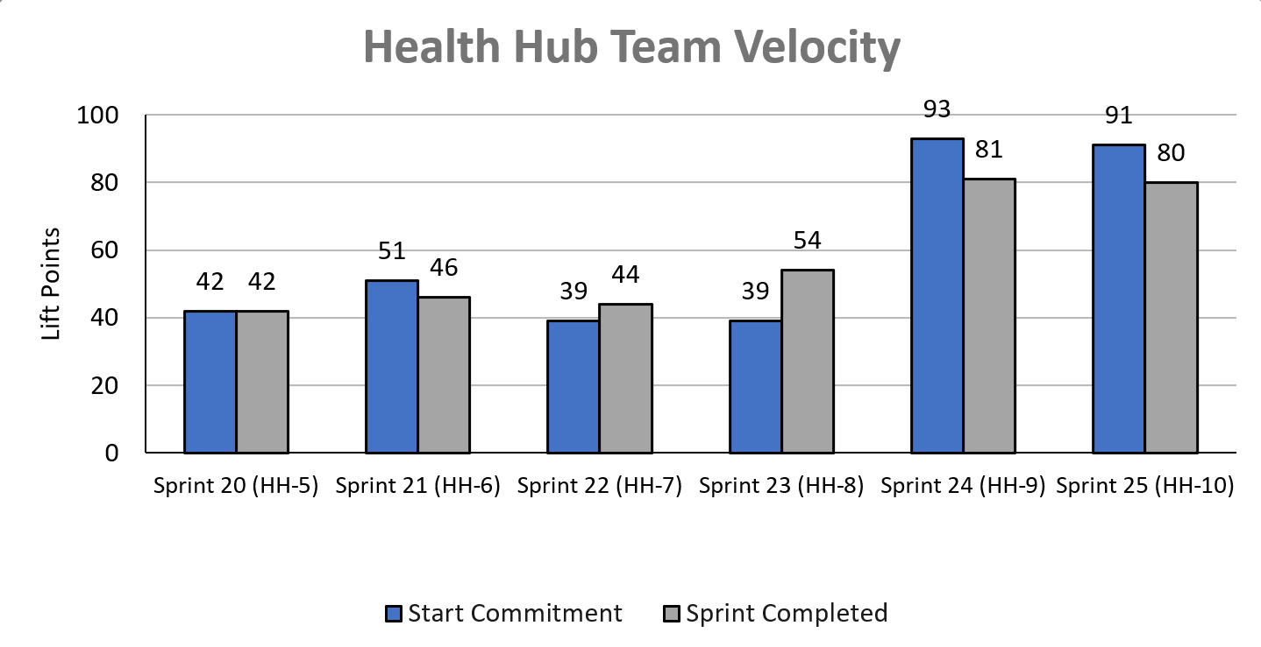
Health Hub team velocity
 | Velocity details Velocity estimated in story points, using Fibonacci Velocity in Sprint 10 accounted for 9 team members 80 total story points were completed; Team committed to 91 story points at beginning of the sprint. 4 Stories (19 points) were blocked and deferred to the new team awaiting built of staging solution. 4 Stories (8 points) were added related to correction of staging review findings
09-07 Sprint 10 Demo
Appendix
28

Slide 29
Project risks and mitigation strategies (1 of 2)
RISK AND IMPACT | MITIGATION STRATEGY | DATE |  | STATUS | NOTES
 |  | ENTERED | CLOSED
IRS stakeholder is outside of VA ecosystem. Building without guidance or legal review regarding compliance with IRS regulation could result in risk. | Conduct research on available information surrounding current IRS 1095-B tax form regulations. Seek legal review through VA resources as directed by VA-PO and Business Owner | 1/20/22 | 2/11/22 |  | VA Business Owner clarified that IRS review is not needed
Team had previously confirmed with Business Owner that legal review was not needed. Business Owner clarified that legal review would be needed as of March 2nd | Business Owner is seeking a POC with the Office of General Counsel to understand what is needed and potential launch impact | 3/2/22 | 5/17/22 |  | Launch blocker
Data requires storage in a S3 bucket that the enrollment system can have access to in production; process to create the staging and production bucket does not have a clear timeline. Without the S3 bucket in prod with enrollment system access, product cannot be built in prod | Daily follow-ups with Jesse House and Mike Chelan (infrastructure team) | 3/1/22 | 3/24/22 |  | S3 bucket now in place. Risk resolved.
Business owner raised User Acceptance Testing should be done with HEC Call Center | Requested Business Owner to schedule UAT with required individuals for mid-March and book as early as possible | 3/2/22 | 3/25/22 |  | Business owner confirmed that UAT can be done through Collaboration Cycle and does not have to be done with HEC team
Feedback from Content and IA Review has taken over a week to come in; feedback is changing our proposal for the H1 and delaying confirmation of where the 1095-B landing page should live, which in turn delays our ability to complete the front end (top nav and side nav bars) | Design team pushing on IA team to confirm final answer of where 1095-B landing page should live and what the H1 header title should be | 03/04/22 | 3/8/22 |  | URL confirmed 3/7 EOD; IA review now closed
09-07 Sprint 10 Demo

Slide 30
Project risks and mitigation strategies (2 of 2)
RISK AND IMPACT | MITIGATION STRATEGY | DATE |  | STATUS | NOTES
 |  | ENTERED | CLOSED
Designs were approved as part of Midpoint Review. Afterwards, Sitewide Content stated they would need to build our front end in Drupal and change our designs, impacting our in-flight build. | Design team met with Sitewide Content to align on redesigned front end. Tech working with Sitewide Content to send over our dynamic widget to be pulled into their static front end. Sitewide Content now owns the front end build. | 3/10/22 | 4/12/22 |  | Launch date dependent on Sitewide Content ability to launch front end
HH Tree Test design held up due to new information from Meg, Danielle and Mikki. | VA and MO team could work in collaborative sessions so that work is not duplicated, and we can arrive at a test design that works by the end of Sprint 3 | 5/16/22 | 5/26/22 |  | Awaiting version of ‘manage’ tree that we can incorporate into research trees in order to move forward with research plan
HEC Legal review required for 1095-B Opt-in | Opt-in is being built by VA Profile team | 3/2/22 | 6/11/22 |  | Post-MVP enhancement blocker
Perigean recruitment / no-shows for HH moderated research could delay synthesis by end of PP | Constant communication with Perigean customer service and rapid reschedule. | 8/22/22 | 9/6/22 |  | Met the 5 participants per cohort goal but one participant technically didn’t meet the study requirements; study closed.
Edge case discovery with newly accessed ES data could delay product readiness for staging review | Ongoing debugging of file upload failures | 8/22/22 | 9/6/22 |  | Staging Review successfully conducted on 9/6/22; all edge cases have been addressed based on processed data.
New process being developed for in staging testing of Drupal page with widget by public websites, will delay staging review | Ongoing monitor of public-websites fix while conducting maximum product testing outside of staging to prevent delays once in staging | 8/23/22 |  |  | To be tested on 9/7.
Product turnover risk mid-staging review which could result in poor transference of backend information due to inability to query documents, code, research | Reached out to VA-PO to request right-left seat of engineer team. Platform team notified of transfer of ownership. | 8/23/22 |  |  | Conducted multiple sessions with Health Apps team; Readme documentation is thorough.
09-07 Sprint 10 Demo

